Slide 1
مخازن موسسه ای
Institutional Repository (IR)
اردیبهشت 97

Slide 2
تعریف
مخازن موسسه ای دانشگاهی مجموعه ای از خدماتی است که دانشگاه به اعضای جامعه خود برای مدیریت و انتشار مواد دیجیتال تولید شده بوسیله موسسه و اعضای جامعه خود ارائه میدهد. این کار اساساً یک تعهد سازمانی برای مدیریت و نظارت بر این مواد دیجیتالی شامل نگهداری دراز مدت این منابع در صورت لزوم، سازماندهی و دسترسی یا توزیع این منابع است. (Clifford Lynch, 2003)

Slide 3
طرح تحول و نوآوری در آموزش علوم پزشکی
  بسته آینده نگاري و مرجعیت علمی در آموزش پزشکی
    در محور:طراحی و استقرار نظام نوآوري در حوزه آموزش علوم پزشکی
    اهداف:: توسعه و استقرار سامانه مخزنی (D-space) ، آرشیو فایل هاي حجمی (مدیا فایل) نوآوري هاي آموزشی
    شاخصهاي پایش: تعداد فایل هاي حجمی آرشیو شده در سامانه مخزنی

Slide 4
مزیتهای مخازن موسسه ای
ارائه تولیدات دانشگاه شامل منابع منتشر شده و منتشر نشده به جهان
افزایش visibility و در نتیجه افزایش تاثیر این منابع
دسترسی سریع و آسان به منابع پژوهشی و آموزشی
صرفه جویی در هزینه ها مانند چاپ و صحافی پایان نامه ها
جمع آوری و سازماندهی منابع تولید شده بصورت دیجیتال
مدیریت و سنجش فعالیتهای آموزشی و پژوهشی
افزایش همکاری بین پژوهشگران
مالکیت فکری و کپی رایت !؟

Slide 5
The Directory of Open Access Repositories - OpenDOAR
Ilam University of Medical Sciences - http://www.medilam.ac.ir/
  Research Repository Portal of Medilam
  http://eprints.medilam.ac.ir/
Kashan University of Medical Sciences (دانشگاه علوم پزشکی کاشان) - http://kaums.ac.ir/
  Kashan University of Medical Sciences Repository
  http://eprints.kaums.ac.ir/
Kerman University of Medical Sciences (KMU) - http://www.kmu.ac.ir/
  Simorgh Research Repository
  http://eprints.kmu.ac.ir/
Qazvin University of Medical Sciences - http://www.qums.ac.ir/
  Qazvin University of Medical Sciences Repository
  http://eprints.qums.ac.ir/
Sabzevar university of medical sciences - http://www.medsab.ac.ir/
  Sabzevar University of Medical Sciences Electronic Publications
  http://eprints.medsab.ac.ir/
Encyclopaedia of Iranian Architectural History (EIAH) (دانشنامهٔ تاریخ معماری ایران‌شهر) - http://eiah.org/
  EIAH Digital Repository
  http://eiah.org/fa/repository
IRAN
Aja University of Medical Sience - http://www.ajaums.ac.ir/
  Ajaums Repository
  http://eprints.ajaums.ac.ir/
ArUMS (Ardabil University of Medical Science) - http://www.arums.ac.ir/
  ArUMS Digital Repository (سامانه اطلاعات زیست پزشکی و سلامت)
  http://eprints.arums.ac.ir/
Ardabil University of Medical Sciences (ArUMS) - http://www.arums.ac.ir/fa/index.html
  Digital library for Ardabil University of Medical Sciences
  http://diglib.arums.ac.ir/greenstone/cgi-bin/library.cgi?a=p&p=home&l=fa&w=utf-8
Bushehr University of Medical Sciences - http://bpums.ac.ir/
  Bushehr University of Medical Sciences Repository
  http://eprints.bpums.ac.ir/
Golestan University of Medical Sciences - http://www.goums.ac.ir/
  Golestan University of Medical Sciences Repository
  http://eprints.goums.ac.ir/I
Notes:
M

Slide 6
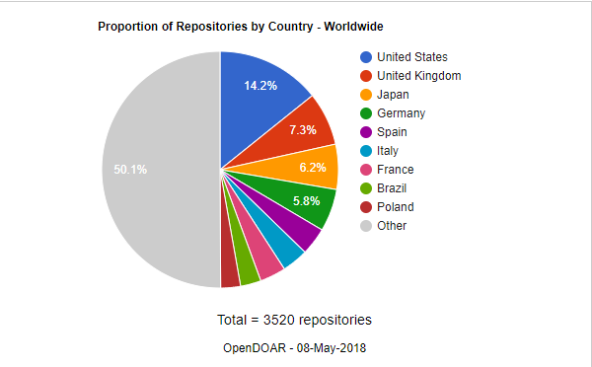
Proportion of Repositories by Country - Worldwide

Slide 7
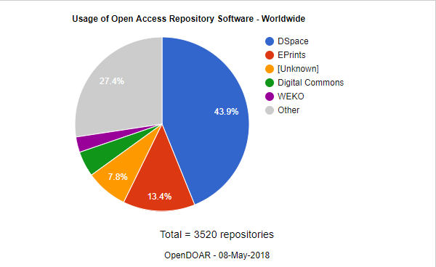
Usage of Open Access Repository Software - Worldwide

Slide 8
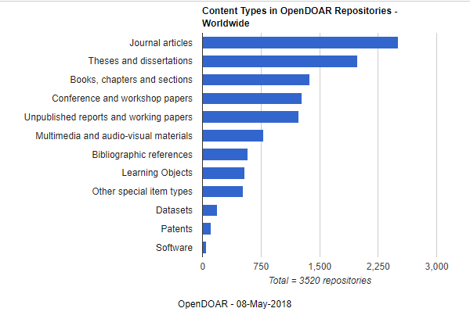
Content Types in OpenDOAR Repositories - Worldwide

Slide 9
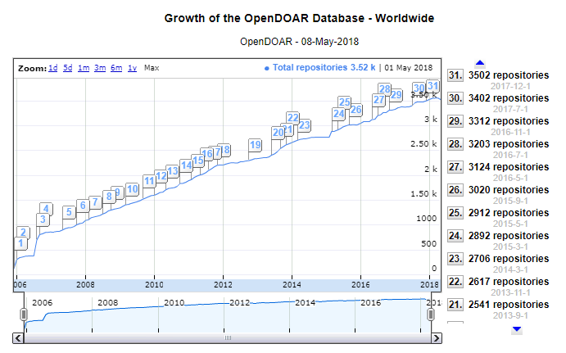

Slide 10
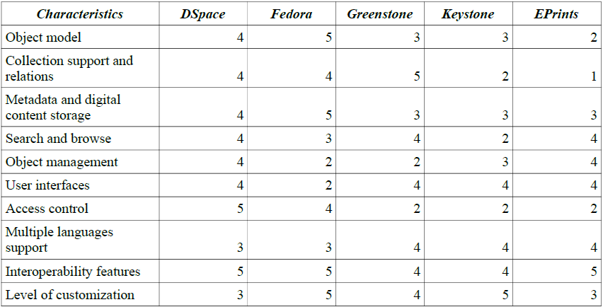
نرم افزارهای متن باز مخزن دیجیتال
DSpace
Fedora
Greenstone
E-Prints
SUM | 40 | 38 | 35 | 33 | 32
Pyrounakis G, Nikolaidou M. Comparing open source digital library software. InHandbook of research on digital libraries: Design, development, and impact 2009 (pp. 51-60). IGI Global.

Slide 11
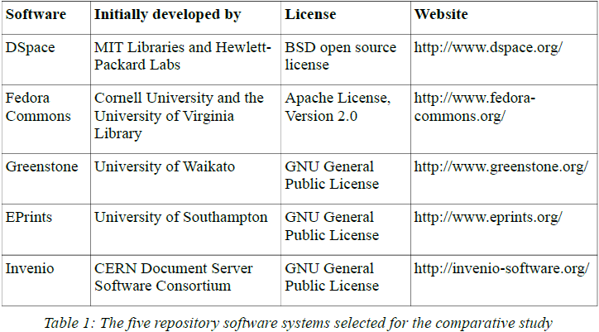
Pyrounakis G, Nikolaidou M, Hatzopoulos M. Building digital collections using open source digital repository software: A comparative study. International Journal of Digital Library Systems (IJDLS). 2014 Jan 1;4(1):10-24.

Slide 12
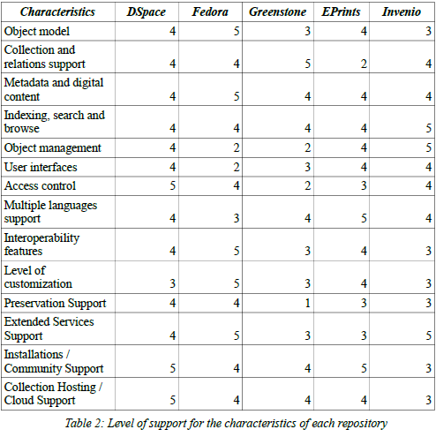
SUM | 58 | 56 | 45 | 53 | 53

Slide 13
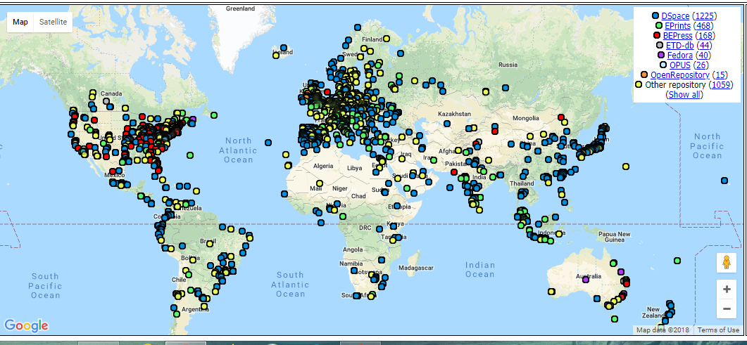

Slide 14
نقش کتابداران در مخزن دانش و داده
مدیریت و حفاظت از مجموعه
آموزش سیستم مخزن دانش و داده به مولفین
راه اندازی ابرداده استاندارد
کنترل کیفیت محتوا
آموزش کاربران برای استفاده از مخزن دانش
ارتقا مخزن دانش

Slide 15


Slide 16
Dspace آشنایی با
اردیبهشت 97

Slide 17

نرم افزار متن باز (Open source) برای مخازن دیجیتالی digital repositories
شروع از 2002 بوسیله MIT و HP
جامعه توسعه فعال (در سال 2017 ورژن 4.x، 5.x و 6.x)
بیش از هزار سازمان از دی اسپیس استفاده میکنند
Notes:
Out of the box solution -- possible to install & run one’s own DSpace, but TDL does it so we don’t have to!
Dspace is part of DuraSpace (Fedora Commons and Dspace)
The most popular open source repository software in USA

Slide 18
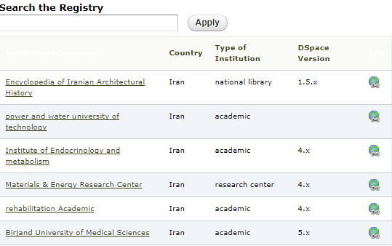
دی اسپیس درایران
شرکت یابش (http://persiandspace.ir/)
دی اسپیس ثبت شده از ایران

Slide 19
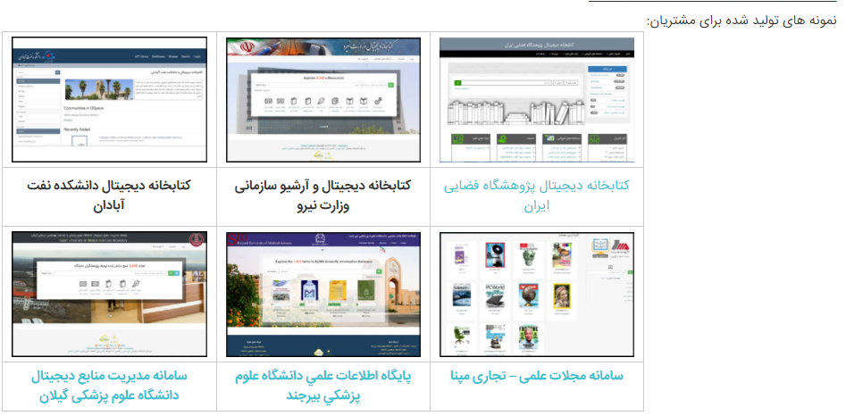

Slide 20
امکانات دی اسپیس
قابل جستجوی متن کامل (هر نوع فایل مبتنی بر متن)
دستیابی: جستجو/مرور در واسط دی اسپیس (Faceted browse)
کار با همه نوع فایل، بهترین برای فایلهای متنی
بهینه شده برای نمایه در Google و Google Scholar
Persistent URLs (Handle system)
Notes:
They really mean it with Google & Google Scholar! (At one workshop, Laura uploaded an existing text file -- a column she’d written -- for practice in the TDL training repository. She got the publication date wrong; now Google Scholar has that column mixed up with the one published on the date she’d put incorrectly, and she cannot get them extricated.)

Slide 21
ابرداده در دی اسپیس
ابرداده توصیفی Descriptive Metadata
  طرح ابرداده فلت برای توصیف یک آیتم
  پیش فرض: ابرداده qualified Dublin Core metadata schema
  امکانات تنظیم و انتخاب فیلدهای ابرداده
ابرداده مدیریتی
  شامل ابرداده های preservation ، provenance و داده سیاست مجوز
ابرداده ساختاری
  شامل روابط بین قسمتهای تشکیل دهنده یک آیتم، اطلاعاتی در مورد نحوه نمایش آیتم یا فایل آن به کاربر نهایی یا ترتیب تصاویر یا صفحات
Notes:
Descriptive Metadata: DSpace can support multiple flat metadata schemas for describing an item. A qualified Dublin Core metadata schema loosely based on the Library Application Profile set of elements and qualifiers is provided by default. The set of elements and qualifiers used by MIT Libraries comes pre-configured with the DSpace source code. However, you can configure multiple schemas and select metadata fields from a mix of configured schemas to describe your items. Other descriptive metadata about items (e.g. metadata described in a hierarchical schema) may be held in serialized bitstreams. Communities and collections have some simple descriptive metadata (a name, and some descriptive prose), held in the DBMS.
Administrative Metadata: This includes preservation metadata, provenance and authorization policy data. Most of this is held within DSpace's relational DBMS schema. Provenance metadata (prose) is stored in Dublin Core records. Additionally, some other administrative metadata (for example, bitstream byte sizes and MIME types) is replicated in Dublin Core records so that it is easily accessible outside of DSpace.
Structural Metadata: This includes information about how to present an item, or bitstreams within an item, to an end-user, and the relationships between constituent parts of the item. As an example, consider a thesis consisting of a number of TIFF images, each depicting a single page of the thesis. Structural metadata would include the fact that each image is a single page, and the ordering of the TIFF images/pages. Structural metadata in DSpace is currently fairly basic; within an item, bitstreams can be arranged into separate bundles as described above. A bundle may also optionally have a primary bitstream. This is currently used by the HTML support to indicate which bitstream in the bundle is the first HTML file to send to a browser. In addition to some basic technical metadata, a bitstream also has a 'sequence ID' that uniquely identifies it within an item. This is used to produce a 'persistent' bitstream identifier for each bitstream. Additional structural metadata can be stored in serialized bitstreams, but DSpace does not currently understand this natively.

Slide 22
ساختار مخزن: جامعه ها و مجموعه ها( Communities and Collections)
Community: بالاترین سطح از سلسله مراتب دی اسپیس، میتواند شامل sub-communitie یا collections باشد
Sub-Community: اختیاری است و میتواند شامل sub-communitie یا collections باشد
Collection: شامل آیتم ها
Item: شامل bitstreams (i.e. files), metadata, and license
Notes:
Communities and Collections are used within DSpace to provide the repository with an easily navigable structure often representing an institutions organizational makeup. (see: http://cadair.aber.ac.uk/dspace/handle/2160/638)
As a result the DSpace repository structure is largely hierarchical.
You can sub-sub-subcommunity as far down as you want to; but once you set up a collection, that’s it. No further granularity.

Slide 23
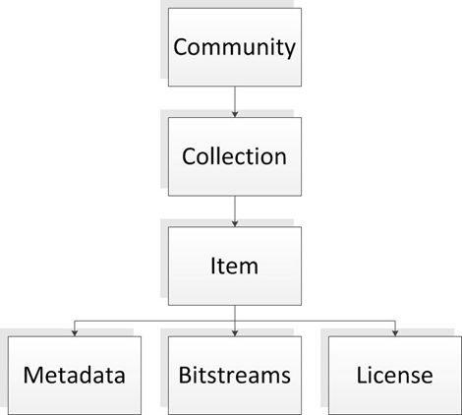
Repository structure: Example #1

Slide 24
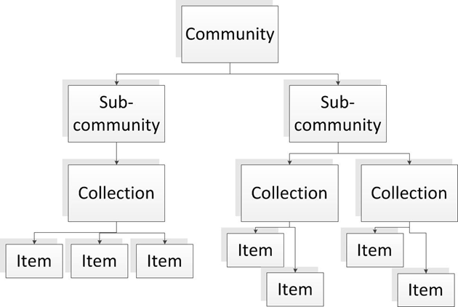
Repository structure: Example #2

Slide 25
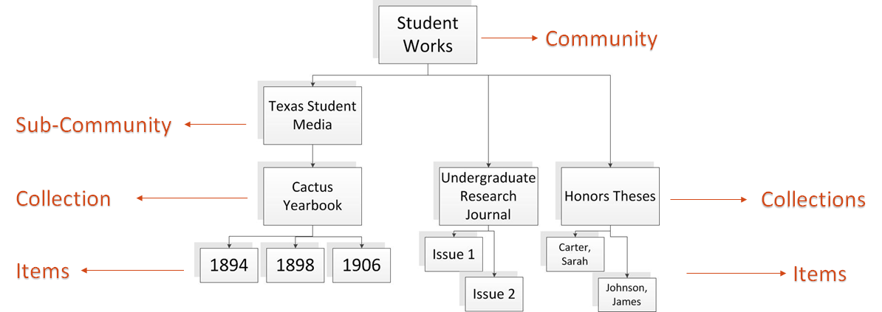
Example from UT Digital Repository

Slide 26
Adding Content in DSpace
Submission Workflow
Notes:
Adding content is also called “ingesting”.

Slide 27
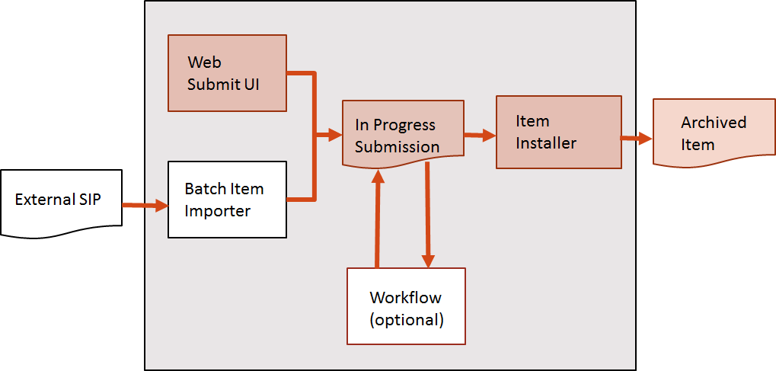
Ingest Process
Notes:
Image Adapted from DSpace 4.x User Documentation:https://wiki.duraspace.org/download/attachments/34640877/ingest.gif?version=1&modificationDate=1262060007225&api=v2
NOTE: We’ll focus on the Web Submit UI process, rather than batch imports. A batch import is when you upload metadata and bitstreams (i.e. files) for multiple Items all at once. Batch import takes an external SIP (an XML metadata document with some content files) and turns it into an "in progress submission" object.
Batch imports *used* to require CLI access, which required support from TDL systems administration; it was limited to large collections of items (200+) or very large files. Laura used a batch import to put up some big video files. She wishes she’d had it for that SEAS stuff we were just looking at, but time was a factor and there wasn’t of it for us to lay all that groundwork. The current build of DSpace has a web-based batch item importer, so you don’t have to mess with all that CLI business anymore.
Batch imports still do require that you have your content files (a.k.a. bitstreams) and metadata all packaged up a special way, called SIP (“Submission Information Package”). The UT Libraries have been working on a SIP packager that will get it all set up automatically, which will be very helpful!
Today we’ll use the Web submission UI, where users go through step by step to assemble an "in progress submission" object. Whereas batch import wants the metadata and content files assembled ahead of time, the Web Submit UI takes manual metadata entry and file uploading.
Depending on the policy of the collection to which the submission is targeted, a workflow process may be started. This typically allows one or more human reviewers or 'gatekeepers' to check over the submission and ensure it is suitable for inclusion in the collection.
When the Batch Ingester or Web Submit UI completes the InProgressSubmission object, and invokes the next stage of ingest (be that workflow or item installation), a provenance message is added to the Dublin Core; this includes the filenames and checksums of the content of the submission. Likewise, each time a workflow changes state (e.g. a reviewer accepts the submission), a similar provenance statement is added. This allows us to track how the item has changed since a user submitted it.
Once any workflow process is successfully and positively completed, the InProgressSubmission object is consumed by an "item installer", converting the InProgressSubmission into a fully blown archived item in DSpace. The item installer:
Assigns an accession date
Adds a "date.available" value to the Dublin Core metadata record of the item
Adds an issue date if none already present
Adds a provenance message (including bitstream checksums)
Assigns a Handle persistent identifier
Adds the item to the target collection, and adds appropriate authorization policies
Adds the new item to the search and browse index
Taken from: https://wiki.duraspace.org/display/DSDOC4x/Functional+Overview#FunctionalOverview-UserManagement

Slide 28
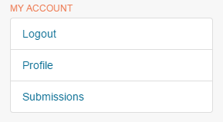
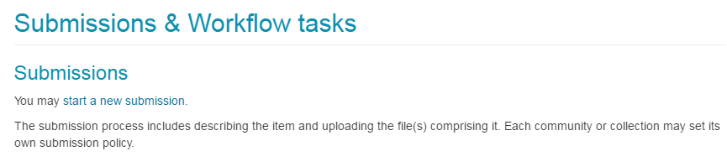
Starting a new submission
Users with “submit” privileges will see a “Submissions” link under My Account.
Click “Start a New Submission” to begin.

Slide 29
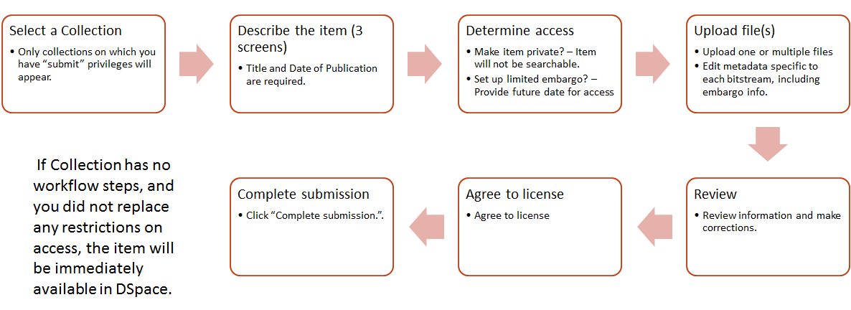
Submission Steps

Slide 30
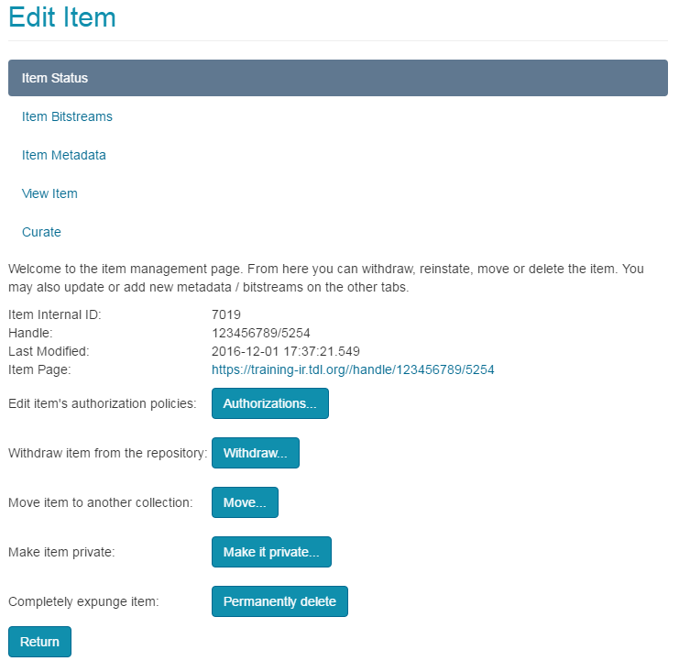
Editing Items
Moving items to a different collection
Making an item private
Replacing or modifying bitstreams
Reordering bitstreams
Editing item metadata

Slide 31
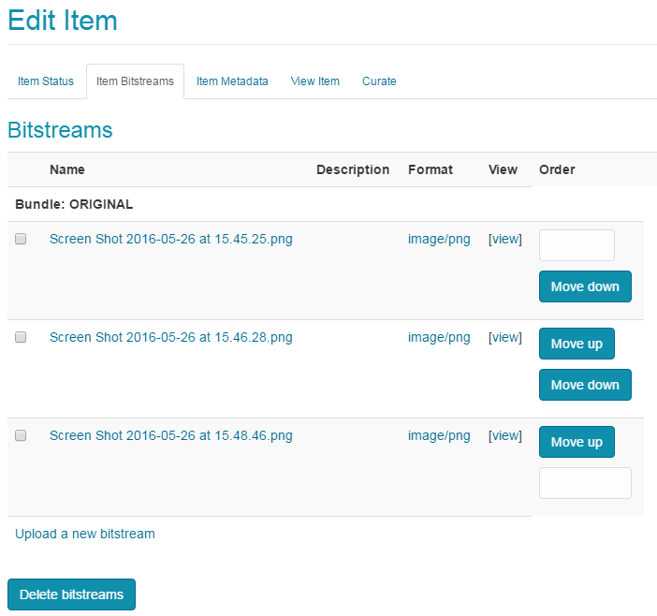
Reorder Bitstreams
In items with multiple files (i.e. bitstreams), an administrator can reorder the files after submission.
Complete submission of item
Navigate to collection and item just submitted
“Edit this item” => Item Bitstreams tab
Use arrows on right side to reorder the files

Slide 32
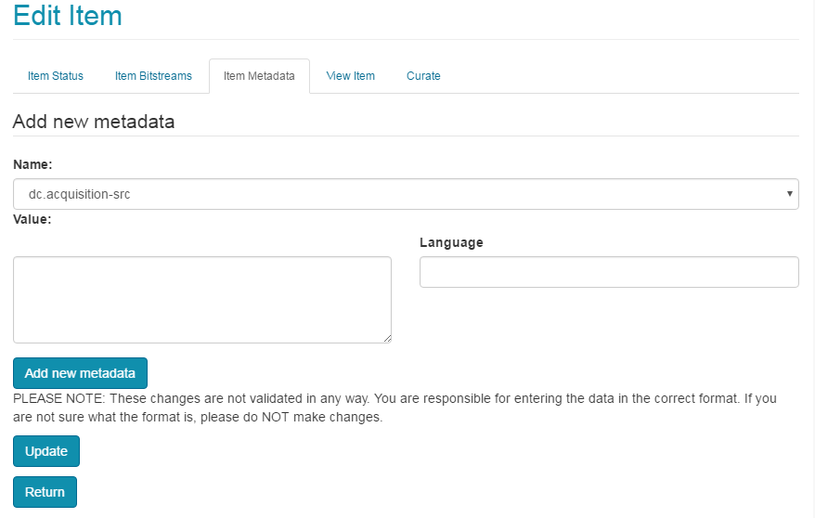
Editing Item Metadata
Navigate to the Item
Click “Edit this item” under “Context.”
Go to “Item Metadata” tab.
Edit existing metadata, or add new fields.

Slide 33
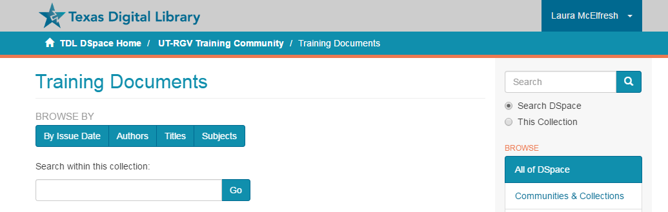
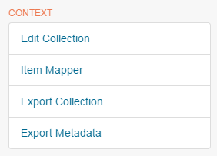
Mapping Items
Navigate to the Collection you wish to map items into
Item Mapper is under “Context” on the right
Search for items and map them in.
Note: this does not move the items -- it just makes them appear in the “Mapped” collection.
Notes:
“Mapping” allows an item that lives in one collection to also show up in a different collection within the same repository (the “owning collection” and “mapped collection”). This way if it makes sense to include an item in more than one place, you can do it without making a whole separate copy of that item.

Slide 34
Roles and Workflows
E-People, Groups, Authorization

Slide 35
Roles within DSpace
More privileges
Fewer privileges
Repository
Administrator
Community
Administrator
Collection
Administrator
Reviewer OR Submitter
Reader
Notes:
User accounts are required in order to grant privileges to different users
Not logged in = Anonymous
Users with accounts can be granted privileges to allow you to interact with DSpace
Repository Administrators have access to all functions in DSpace.
Important Note: Reviewer is a role specific to Workflows

Slide 36
E-People and Groups
E-People and Groups are the way DSpace identifies users for the purpose of granting privileges.

Slide 37

E-People
E-Person = User Account
An E-Person can be granted certain privileges within DSpace.
In TDL-hosted systems, an E-Person is created when a user logs in for the first time.

Slide 38

Groups
Groups = a list of E-People
Groups can be granted permissions
Anyone added to the group gets the permissions granted to the group
Two default groups in DSpace: Administrator and Anonymous

Slide 39
Roles within DSpace
More privileges
Fewer privileges
Repository
Administrator
Community
Administrator
Collection
Administrator
Reviewer OR Submitter
Reader
Anonymous
(by default)
Administrator
Collection_X_Submit
Collection_X_Workflow_Step_1
Collection_X_Workflow_Step_2
Collection_X_Workflow_Step_3
Community_X_Admin
Collection_X_Admin
Notes:
Each role in DSpace is associated with a named Group.
Important Note: Reviewer is a role specific to Workflows (see later slides)
The default Group for Reader in “Anonymous,” meaning that by default, a Collection can be viewed and read by any user, whether logged in or not. Restricted groups CAN be created for the Reader role – i.e. access to items in the repository can be restricted to a specific group.

Slide 40
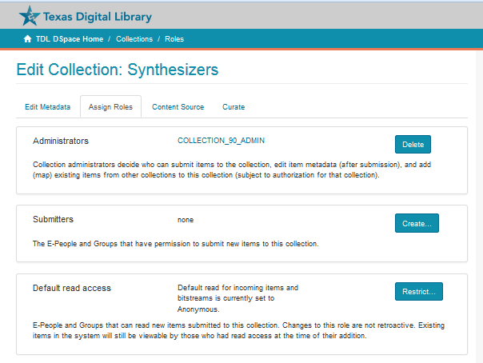
Managing Groups
(Method 1)
Edit Collection → Assign Roles
Create a group of Collection
Administrators
Create a group of Submitters
Create a specified Group who can access materials (default is “anonymous)
To create a group: Click “Create” (or “Restrict), search for and add E-People to the group, click SAVE

Slide 41
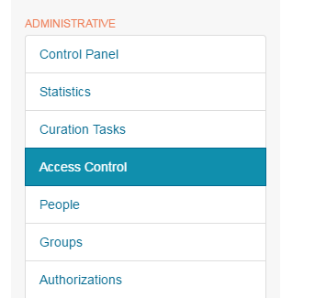
Managing Groups
(Method 2)
Access Control → Groups
To create a Group: Click “Click here to add a new Group,” give new Group a name, search for and add E-People to the group, click SAVE.
Note: No privileges are attached to any groups created through this method. But groups created here are available to be authorized in other parts of the interface.

Slide 42

Workflows
Without a Workflow in place, items submitted to a Collection in DSpace will automatically be archived and published.
Workflows allow for one, or multiple, steps for reviewing submissions and editing metadata prior to publication.
A Workflow can have 1, 2, or 3 steps.
Each step will have an E-Person Group attached.

Slide 43
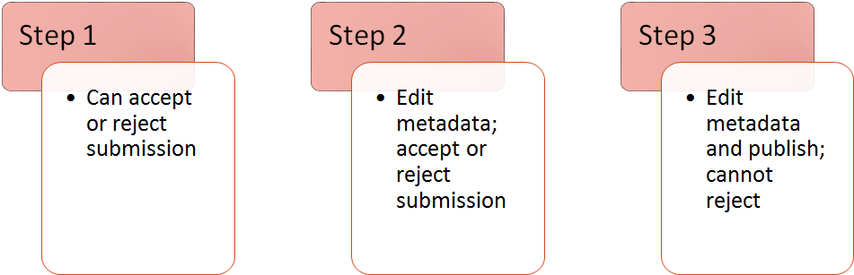
Available Workflow Steps
Notes: A collection might have one or all of these steps. It could have any one of these steps but not the other two.

Slide 44
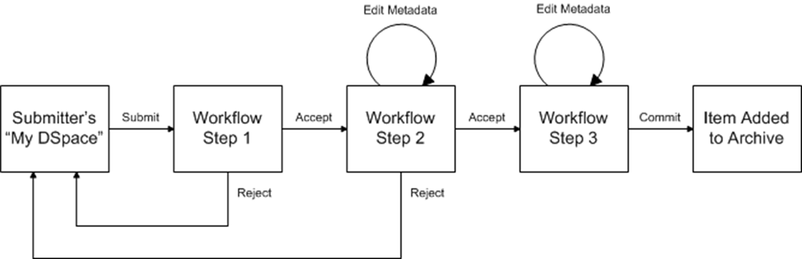
A Workflow with all three steps
Notes:
Image location: https://wiki.duraspace.org/download/attachments/34640877/workflow.gif?version=1&modificationDate=1262060007223&api=v2

Slide 45
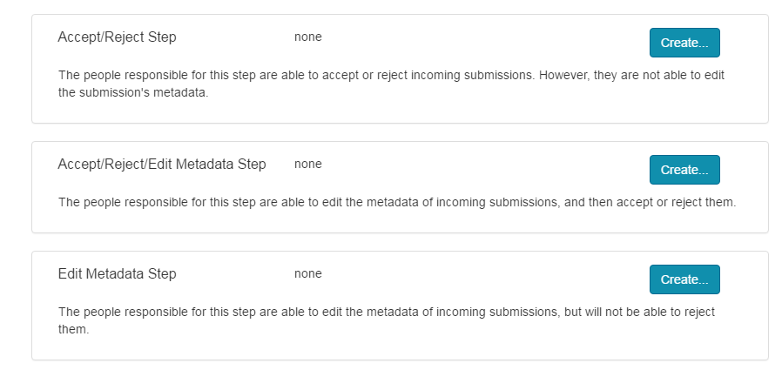
Creating a Collection Workflow
Edit Collection → Assign Roles
Create a Group for the Workflow step(s) you want.
A step without a Group does not exist.

Slide 46
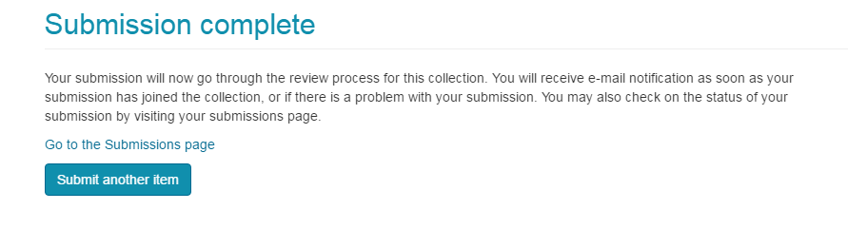
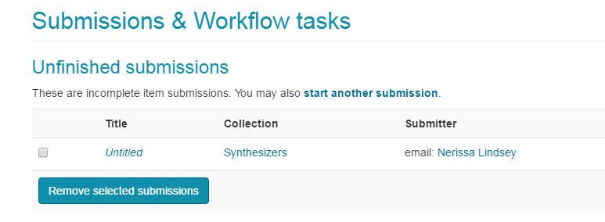
Working Within a Workflow
Submitter submits item to a Collection with “Step 2” in place. Submitter gets this message:
An email is sent to every E-Person in the Workflow/Reviewer Group.
Reviewer Group also sees this on their Submissions page:

Slide 47
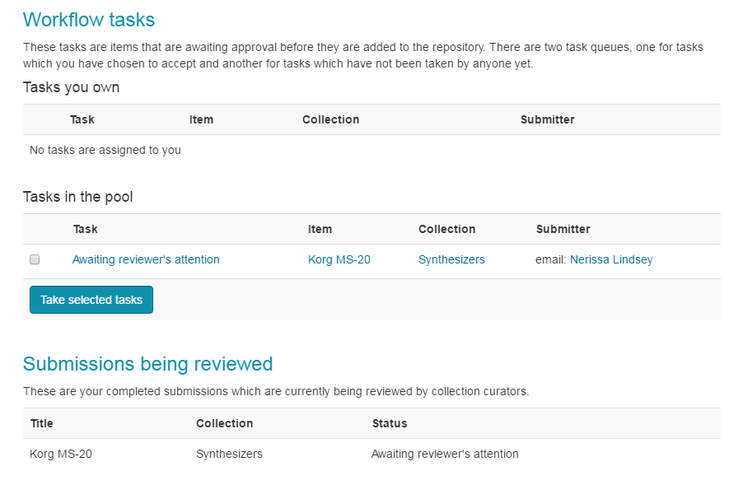
Workflow Cont.
Review takes the task and reviews submitted item.
Reviewer can edit the item’s metadata, approve or reject the item, or return the item to the pool for another Reviewer to pick up.

Slide 48

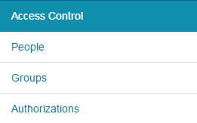
Authorization Policies
VERY specific permissions can be created for e-persons and groups by creating authorization policies at the Collection, Item, or Bitstream Level.
Notes:
“Authorization” refers to an even more granular level of permissions that can be controlled at the Collection, Item, or Bitstream Level.

Slide 49
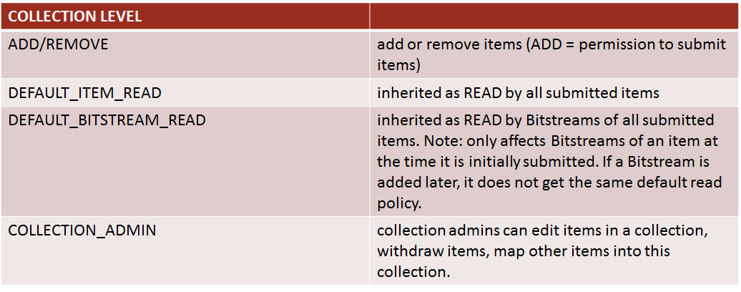
Collection-Level Authorization Policies

Slide 50
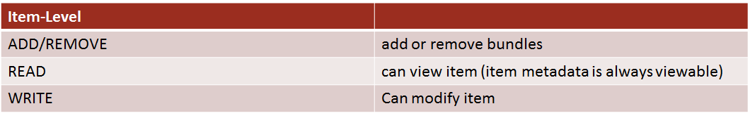
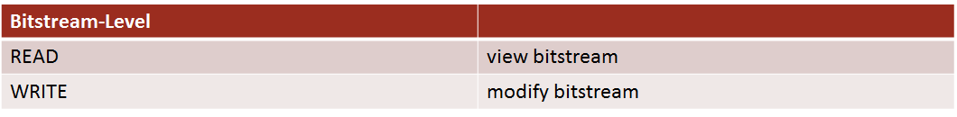
Other Authorization Policies

Slide 51
Metadata Management in DSpace
Batch edits & metadata cleanup
Moving/mapping Items en masse
Fun with spreadsheets!
Notes:
(If we can’t get through this part in today’s training, I can come back another time to work on it with y’all. It might also be a good topic for an intermediate session.)
We do this by exporting metadata into a CSV spreadsheet, manipulating the spreadsheet (using your normal processes in Excel or whatever), and then uploading the edited spreadsheet back into the repository.

Slide 52
How To:
Navigate to a Community or Collection
Under “Context”, click “Export Metadata”
Save the .csv file and open it in Excel
Columns MUST have metadata element names as headers
Can take out columns you’re not editing
  Do not take out “id” and “collection”
Use a double pipe “||” to include multiple values for an element
  Lindsey, Nerissa||McElfresh, Laura
Perform batch operations in your Collection
Edit metadata
Move/map Items

Slide 53
How To:
Map an item by including multiple values under “collection”
Move an item by changing the “collection”
Save the edited file (make sure it’s .csv)
Under “Content Administration”, click “Import Metadata”
“Choose File”, find your .csv file, and click “Upload CSV”
Approve the changes, and you are done!
Perform batch operations (cont.)

Slide 54
Practice
(We will walk & talk you through this.)
Perform batch operations on repository metadata

Slide 55
But wait! There’s more!
Highlights of Other DSpace Features

Slide 56
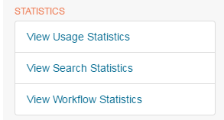
Statistics in Dspace
Usage statistics can be retrieved for your DSpace instance as a whole, and from individual item, collection and community pages. These Usage Statistics pages show:
Total page visits (all time)
Total Visits per Month
File Downloads (all time)
Top Country Views (all time)
Top City Views (all time)
Alternatively, you can connect your repository to Google Analytics which is more robust: https://wiki.duraspace.org/display/DSDOC5x/DSpace+Google+Analytics+Statistics

Slide 57
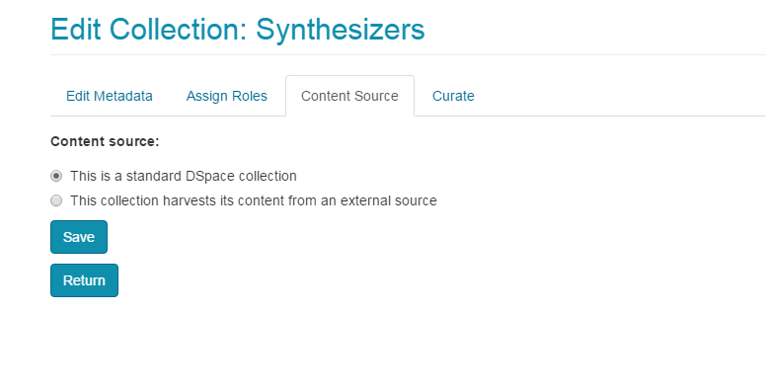
Harvesting
• DSpace exposes metadata for collection by harvesters using the OAI-PMH protocol.
• DSpace can also harvest metadata and/or objects from other OAI-compliant repositories.
• Harvesting of another collection is configured under “Content Source.”
Documentation: https://wiki.duraspace.org/display/DSDOC5x/OAI

Slide 58
MathJax and other DSpace 5 features
MathJax and other DSpace 5.0 features can be learned about here:
https://tdl-ir.tdl.org/tdl-ir/handle/2249.1/76167

Slide 59
باتشکر

